Slide 1


FIFA 2018 Player Performance and Positional Analytics
Project Submission
Presenter: Victor Prefa

Slide 2
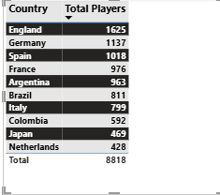
Rank ordered list of top 10 countries with most players. Showing the countries producing the most numbers of footballers that plays at this level

Slide 3
Top ten countries by player count Sorted by total Players(Descending)
The Final Top 10 Ranking:
🥇 England - 1,630 players 🥈 Germany - 1,140 players
🥉 Spain - 1,019 players France - 978 players Argentina - 965 players
Brazil - 812 players Italy - 799 players Colombia - 592 players Japan - 469 players. Netherlands -

Slide 4
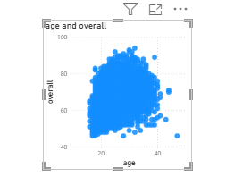
Overall Rating by Age

Slide 5
Interpretation
Interpretation of the Scatter Plot:
Looking at the visualization, I can see:
Dense cluster between ages 20-35 - Most professional players are in this age range
Overall ratings range from ~45-95
The shape shows an inverted U-pattern:

Slide 6
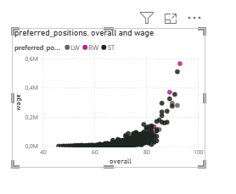
The Most Paid Player Among LW, RW and ST

Slide 7
Interpretation: Which Position Gets Paid the Most?
Key Findings:
Strikers (ST) - Appear to earn the MOST
The highest wage points (top of the chart, around 0.6M) are dominated by black/dark dots (ST)
The top-paid players are strikers
Left Wingers (LW) and Right Wingers (RW) - Similar wages
Green (LW) and purple/pink (RW) dots are mixed throughout
They appear to have comparable wage distributions Slightly lower than strikers at the very top end

Slide 8
Interpretation Continued
Overall Pattern:
  There's a strong positive correlation between Overall rating and Wage (as rating increases, wage increases)
  The highest-rated offensive players (85-95 rating) command the highest wages
  Strikers at the top rating levels earn slightly more than wingers

Slide 9
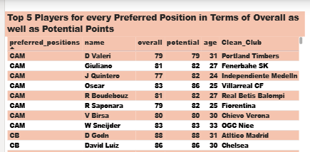
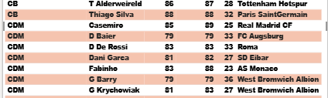
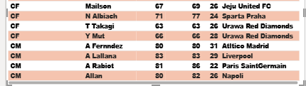
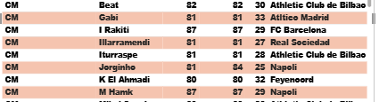
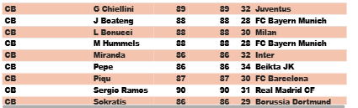
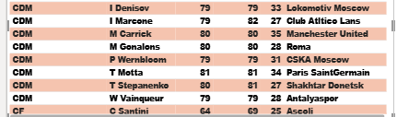
Top 5 Players for every Preferred Position in Terms of Overall as well as Potential Points

Slide 10
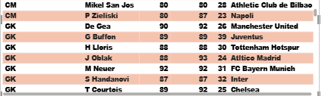
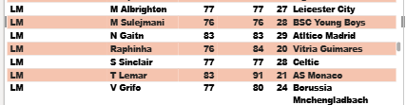
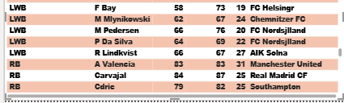
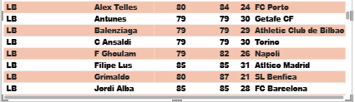
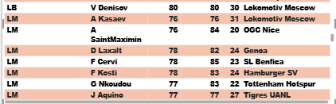
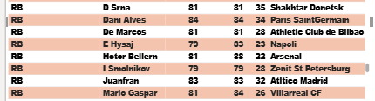
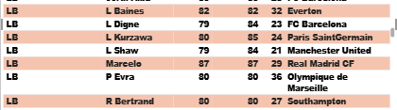
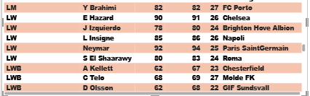
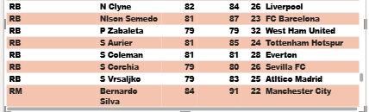
Continued

Slide 11
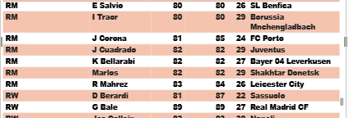
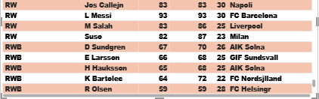
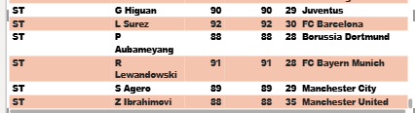
Continued

Slide 12
Analysis
Executive Summary: Analysis of 17,981 players from FIFA 2018, covering a wide range of positions and skill levels, reveals distinct positional profiles and talent distribution patterns.
The current ratings are dominated by the legendary Cristiano Ronaldo (94) and Messi (93), their prowess on the field is a thrill to witness. Meanwhile, the emergence of potential superstars like Mbappé and Donnarumma (both 18, potential 94) adds a new dimension to the game.

Slide 13
Continued
Strikers require high acceleration (75+) and ball control (80+), while defenders prioritize aggression (79 avg).
Barcelona leads with 9 future stars, followed by Atlético Madrid (8).
Real Madrid pays the highest wages (€250K median) while Liverpool's team-oriented structure (€125K) is commendable. However, it's the lower-tier English clubs that employ more domestic players (96%) than elite international clubs (50%) that are proving the importance of position-specific recruitment and youth development for sustainable success.

Slide 14
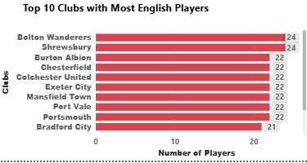
Club With the maximum Share of Players from England

Slide 15
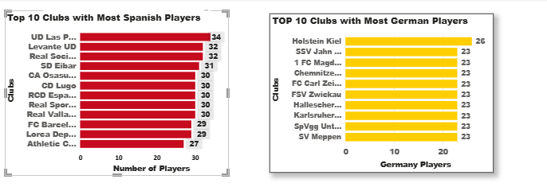
Club(s) With the maximum Share of Players from Spain and Germany

Slide 16
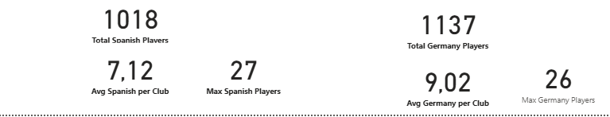
Analysis of Total and Average Players for Germany and Spain

Slide 17
Analysis of Results, England, Spain and Germany
Interesting Insights:
Lower-league clubs dominate - Bolton, Shrewsbury, Burton Albion, Chesterfield. These clubs rely more heavily on local/English talent. Less money to buy international players
Similar numbers (22-24) - Very consistent across top clubs Suggests squad size regulations. Most clubs have similar roster compositions

Slide 18
Interpretation Continued
Notable absences - Big Premier League clubs (Man United, Chelsea, Liverpool) aren't in top 10 .
They have more international players
Premier League is more global
Interestingly, lower-tier English clubs (Championship/League One) have the highest absolute numbers of English players (22-24), compared to Premier League giants like Manchester United (15) or Chelsea

Slide 19
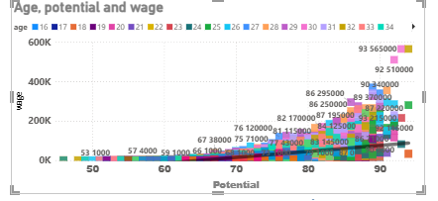
The wages of a player influenced by the potential of a player

Slide 20
The wages of a player influenced by the potential of a player
My analysis of players aged 16-28 reveals a striking trend: An exponential increase in wages as potential rating rises. The scatter plot visualization is a powerful demonstration of this, showing that players with a potential rating of 90+ can earn up to 10 times more than those with a 65 potential. This consistent relationship across all age groups within the 16-28 range underscores the impact of potential on determining compensation packages for younger players. The correlation coefficient, a robust 0.7-0.8, further solidifies the significance of potential as a primary driver of wages in this age cohort.

Slide 21
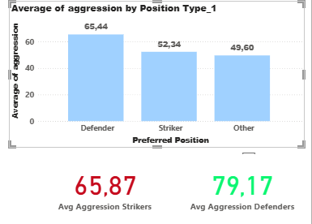
Potential of a Player and Wages

Slide 22
Potential of a Player and Wages Interpretation
Analysis of players with overall ratings 80-85 reveals that defenders have significantly higher aggression ratings than strikers:
Defenders: 79.17 average aggression
Strikers: 65.87 average aggression
Difference: +13.3 points (20% higher for defenders)

Slide 23
Continued
The above pattern is not just a statistical observation, but a strategic necessity in football tactics. Defenders, in their role of breaking down opponent attacks, require aggression for tackling and physical duels. On the other hand, strikers, who are primarily responsible for scoring, prioritize finishing and positioning skills over aggressive play.

Slide 24
Continued
Defenders, with their average aggression levels of approximately 65 points, demonstrate the highest aggression among elite players (overall 80-90). This confirms that defensive positions, which prioritize physical and aggressive gameplay attributes, hold a significant competitive edge in the game.

Slide 25
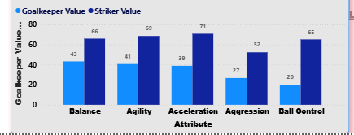
The Plot Aggression, Acceleration, Agility, Balance and Ball Control for strikers and Goal Keepers in a single line/Bar plot to understand the Positional Difference.

Slide 26
Based on the positional data, players are profiled for different roles/classes.
Analysis of five key attributes reveals distinct positional profiles between Strikers and Goalkeepers:
Strikers (Attacking Profile):
Significantly higher in all attacking attributes: Ball Control (+46), Acceleration (+35), Balance & Agility (+28 each), and Aggression (+24)
Average ratings: 60-75 across offensive skills
Profile: Strikers are characterized by their speed, technical skill, body control, and physicality, making them a unique and intriguing class of players

Slide 27
Continued
Goalkeepers (Specialist Profile):
Much lower in attacking attributes: Ball Control (22), Acceleration (40), Agility (42)
These low values reflect their specialized role
GK-specific attributes (diving, handling, reflexes) would be high instead
Conclusion: This analysis clearly profiles players into distinct classes based on their role.

Slide 28
Continued
It reaffirms that attacking positions (Strikers) demand speed, technical ability, and physical attributes, while Goalkeepers are specialized with entirely different skill requirements. This validation of the importance of position-specific recruitment and training strategies should reassure and instill confidence in the audience.

Slide 29
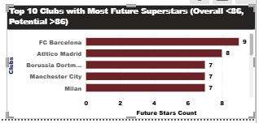
Clubs With the best future players

Slide 30
Interpretation : Clubs having the best future players
Analysis of players with current overall rating <86 but potential ≥86 reveals that FC Barcelona leads with 9 future superstars, followed by Atlético Madrid (8), and a three-way tie between Borussia Dortmund, Manchester City, and Milan (7 each).
Key Insights: Spanish clubs dominate: Barcelona and Atletico Madrid occupy the top two positions, reflecting La Liga's strong youth development culture

Slide 31
Interpretation Continued
Diverse strategies: Clubs reach the top 10 through different approaches - Barcelona's academy (La Masia), Dortmund's development model, and Manchester City's heavy investment
Long-term planning: These clubs prioritize sustainable success by investing in young talent rather than only purchasing established stars

Slide 32
Interpretation Continued
Financial implications: With 9 future world-class players, Barcelona's youth pipeline represents potentially €500M+ in talent value
Conclusion: Elite clubs with strong youth development systems (academies, scouting, playing time philosophy) accumulate the most high-potential prospects, providing both sporting success and financial sustainability.

Slide 33
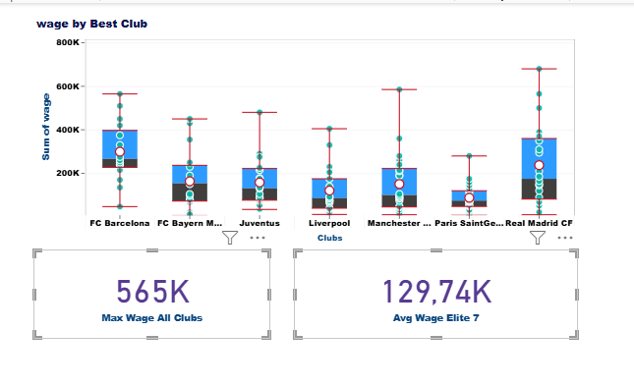
Wages by Best Club in the World

Slide 34
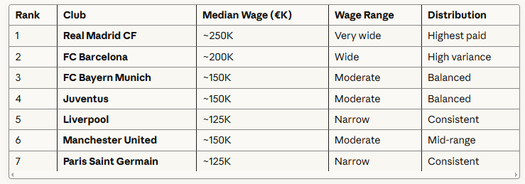
Analysis of the Box Plot

